Slide 1
Advanced Topics
Sessions, TempData, Cache, Hosting, Performance, GDPR
SoftUni Team
Technical Trainers
Software University
http://softuni.bg

Slide 2
Table of Contents
Sessions, Cache, TempData
Authentication & Authorization Fundamentals
GDPR
Hosting & Environment
Performance & SEO
Repository & AutoMapper

Slide 3
Have a Question?
sli.do #csharp-web

Slide 4

Sessions, Cache & TempData
Application State

Slide 5
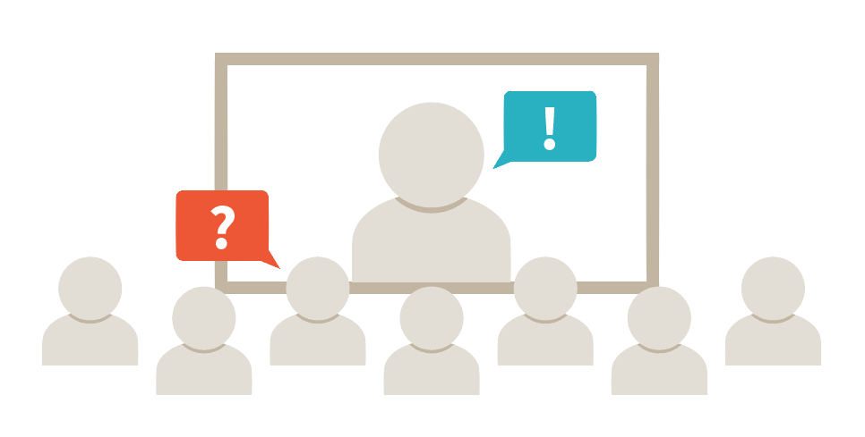

Sessions
Session state is an ASP.NET Core scenario for storage of client data
Each client has a unique Session ID which the framework stores
Data can be maintained while the client browsers the application
Session data is backed by cache, and is considered ephemeral
The application should continue to function without session data

Slide 6
Sessions
Enabling Session middleware, setting up in-memory session provider
public void ConfigureServices(IServiceCollection services)
{
// services.AddMemoryCache(); // Default in-memory cache – provides IMemoryCache
services.AddDistributedMemoryCache(); // Provides IDistributedCache
services.AddSession(options =>
{ options.IdleTimeout = TimeSpan.FromSeconds(10); // Set a short timeout for easy testing
options.Cookie.HttpOnly = true; // XSS security
});
services.AddMvc();
}
public void Configure(IApplicationBuilder app, IHostingEnvironment env)
{
...
app.UseSession(); // UseSession() Middleware must be called before UseMvc()
app.UseMvc();
}

Slide 7
Sessions
After the Session state is configured, HttpContext.Session is available
ASP.NET Core Sessions store byte array values to ensure serialization
You may need specific approaches in order to store complex data
public IActionResult GetShoppingCart()
{
if (this.HttpContext.Session.Get("Cart") == null)
{
this.HttpContext.Session.SetString("Cart", JsonConvert.SerializeObject(new Cart()));
}
this.ViewData["Cart"] = this.HttpContext.Session.GetString("Cart") == null
? null
: JsonConvert.DeserializeObject(this.HttpContext.Session.GetString("Cart"));
return View();
}

Slide 8
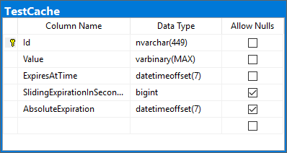
Sessions
We can persist session and cache data in a SQL server database
public void ConfigureServices(IServiceCollection services)
{
services.AddDistributedSqlServerCache(
options =>
{
options.ConnectionString = Configuration.GetConnectionString("DefaultConnection");
options.SchemaName = "dbo";
options.TableName = "TestCache";
});
// services.AddDistributedRedisCache()
services.AddSession();
}
The cache table is created using the sql-cache command
dotnet sql-cache create "Data Source=.;Initial Catalog=db;Integrated Security=True;" dbo TestCache

Slide 9
Sessions
You can implement Session Extension methods to ease your work
public static class SessionExtensions
{
public static void Set<T>(this ISession session, string key, T value)
{
session.SetString(key, JsonConvert.SerializeObject(value));
}
public static T Get<T>(this ISession session, string key)
{
var value = session.GetString(key);
return value == null ? default(T)
: JsonConvert.DeserializeObject<T>(value);
}
}

Slide 10

Working with Sessions
Live Demo

Slide 11
Temp Data
Store data until it’s read

Slide 12



TempData
ASP.NET Core exposes the TempData property in:
Razor Page page models
MVC Controllers
The property stores data until it’s read
Keep() and Peek() methods avoid deletion when data is examined
TempData is:
Particularly used for redirection
When data is required for more than a single request

Slide 13


TempData
TempData is implemented by TempData providers
Using either Cookies or Session State
As of ASP.NET Core 2.0, the default TempData provider is cookie-based
public void ConfigureServices(IServiceCollection services)
{
services.AddMvc().AddSessionStateTempDataProvider();
services.AddSession(...);
}
public void Configure(IApplicationBuilder app, IHostingEnvironment env)
{
...
app.UseSession();
app.UseMvc();
}

Slide 14

TempData
After enabling the TempData, you can access it in:
Your Controller, and Actions
Your Razor Page page model
public IActionResult RedirectToTempData()
{
this.TempData["Previous"] = "/Home/RedirectToTempData";
return this.RedirectToAction("AccessTempData");
}
public IActionResult AccessTempData()
{
this.HttpContext.Response.Headers.Add("Previous", this.TempData["Previous"].ToString());
// Add a HttpHeader ("Previous") with the previous Action URL.
return this.View();
}

Slide 15
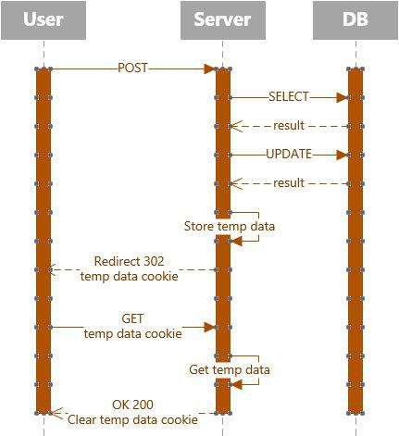
TempData

Slide 16
Working with TempData
Live Demo

Slide 17
Cache
An efficient way to store data

Slide 18
Cache
Cache makes a copy of a piece of data and stores it
Can be extracted much faster than from its original source
Significantly improves application performance
Works best with data that does not change frequently
ASP.NET Core supports several different caches
The simplest cache is based on the IMemoryCache
An in-memory cache stored on the app Server’s memory
Can store any type – primitive or complex (object)

Slide 19

Cache
In-memory Cache is configured as a simple service
public void ConfigureServices(IServiceCollection services)
{
services.AddMemoryCache(); // Add the IMemoryCache as a dependency to the DI
services.AddMvc();
}
public class HomeController : Controller
{
private IMemoryCache cache;
public HomeController(IMemoryCache memoryCache)
{
this.cache = memoryCache; // Inject the IMemoryCache through DI
}
...
}

Slide 20
Cache
Here is an example of a cache DateTime value
public IActionResult GetCachedData()
{
DateTime cacheEntry;
if (!this.cache.TryGetValue(CacheKeys.Entry, out cacheEntry)) // Look for cache key.
{
cacheEntry = DateTime.Now; // Key not in cache, so get data.
var cacheEntryOptions = new MemoryCacheEntryOptions() // Set cache options.
.SetSlidingExpiration(TimeSpan.FromSeconds(3)); // Keep in cache for this time.
// Reset time if accessed.
// Save data in cache.
this.cache.Set(CacheKeys.Entry, cacheEntry, cacheEntryOptions);
}
return View("Cache", cacheEntry);
}

Slide 21


Cache
The cached DateTime value remains in the cache
Its value is untouched, from the moment of caching
There are requests within the timeout period
No eviction is done due to memory pressure
<h3>Current Time: @DateTime.Now.TimeOfDay.ToString()</h3>
<h3>Cached Time: @(Model == null ? "No cached entry found" : Model.Value.TimeOfDay.ToString())</h3>

Slide 22
Cache
The framework also supplies you with a convenient Tag Helper
The Cache Tag helper caches content to the internal cache provider
<cache>
Current Time: @DateTime.Now
</cache>
<cache expires-on="@new DateTime(2025,1,29,17,02,0)">
Current Time: @DateTime.Now
</cache>
<cache enabled="true">
Current Time: @DateTime.Now
</cache>
<cache expires-after="@TimeSpan.FromSeconds(120)">
Current Time: @DateTime.Now
</cache>
<cache expires-sliding="@TimeSpan.FromSeconds(60)">
Current Time Inside Cache Tag Helper: @DateTime.Now
</cache>

Slide 23
HTTP Response Cache
There are other types of Cache, like HTTP-based Response Caching
The primary HTTP header for caching is Cache-Control
It is used to specify caching directives
These directives control caching behavior during communication
Response Caching in ASP.NET Core is controlled by a simple middleware
public void ConfigureServices (IServiceCollection services)
{
...
services.AddResponseCaching();
...
}
public void Configure(IApplicationBuilder app, IHostingEnvironment env)
{
...
app.UseResponseCaching();
...
}

Slide 24
HTTP Response Cache
Once enabled, you can configure it:
Manually in Request Handlers
With attributes, on Controller Actions
The convenient built-in ResponseCache attribute is quite useful
The attribute’s properties are used to configure the Caching
[ResponseCache(Duration = 30, Location = ResponseLocation.None, NoStore = true)]
public IActionResult Error()
{
...
}

Slide 25
Working with Cache
Live Demo

Slide 26
Post-redirect-Get
Post-redirect-Get (PRG) is a design pattern in web development
POST requests should be answered with a REDIRECT
The REDIRECT response should trigger a GET request in the client
Post-redirect-Get is designed to reduce duplicate form submissions
These are caused by clients refreshing or navigating back and forth
Post-redirect-Get has a major role in most applications
Duplicate form submissions can be critical in Store applications
Duplicate form submissions may cause undesired Data spam

Slide 27
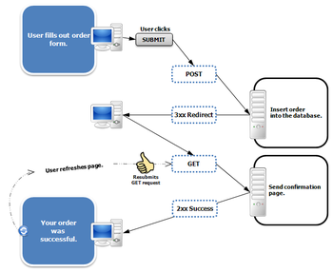
Post-redirect-Get
PRG is a pattern, and is not that hard to implement
[HttpGet]
public IActionResult Create()
{
return View(new ProductModel());
}
[HttpPost]
public IActionResult Create(ProductModel productModel)
{
if (!ModelState.IsValid)
{
return View(productModel);
}
// Do magic with productModel
return RedirectToAction("Details", { id });
}

Slide 28

More Authentication & Authorization

Slide 29




Authentication & Authorization Types
There are many types of auth in ASP.NET Core applications
Cookie-based Authentication & Authorization (Identity)
Windows Authentication & Authorization
Cloud-based Authentication & Authorization
JSON Web Tokens (JWT) Authentication & Authorization

Slide 30


Cookie-Based Authentication & Authorization
Cookie-Based auth is the ASP.NET Core app auth mechanism
Authentication is entirely Cookie-based
This is a major difference from ASP.NET MVC
The Principal is based on claims

Slide 31


Windows Authentication & Authorization
Windows auth is a more complex auth mechanism
Relies on the operating system to authenticate users
Credentials are hashed before sent across the network
Best suited for intranet environments
Clients, Users, Servers belong to the same Windows domain (AD)

Slide 32


Cloud-based Authentication & Authorization
Cloud-based auth is a more modern authentication approach
Authentication & Authorization work is outsourced
An external platform handles the User functionality
Ensures flexibility and speed
Greatly decouples the auth functionality from the others

Slide 33



JWT Authentication & Authorization
JSON Web Tokens is a modern JavaScript-based auth mechanism
Compact and self-contained
Focused on signed tokens
Work with claims
Data is encrypted
Used for auth & information exchange
Commonly used, when developing REST
Extremely simple to comprehend
Used in Angular/React/Vue.js/Blazor applications

Slide 34
Social Accounts
Enabling users to sign in with their existing credentials is convenient
Shifts the complexities of managing the sign-in process to third party
Enhances user experience by minimizing their auth activities
ASP.NET Core supports built-in external login providers for:
Google
Facebook
Twitter
Microsoft
public void ConfigureServices(IServiceCollection services)
{
...
services.AddAuthentication()
.AddGoogle(googleOptions => { ... })
.AddFacebook(facebookOptions => { ... })
.AddTwitter(twitterOptions => { ... })
.AddMicrosoftAccount(microsoftOptions => { ... });
...
}

Slide 35
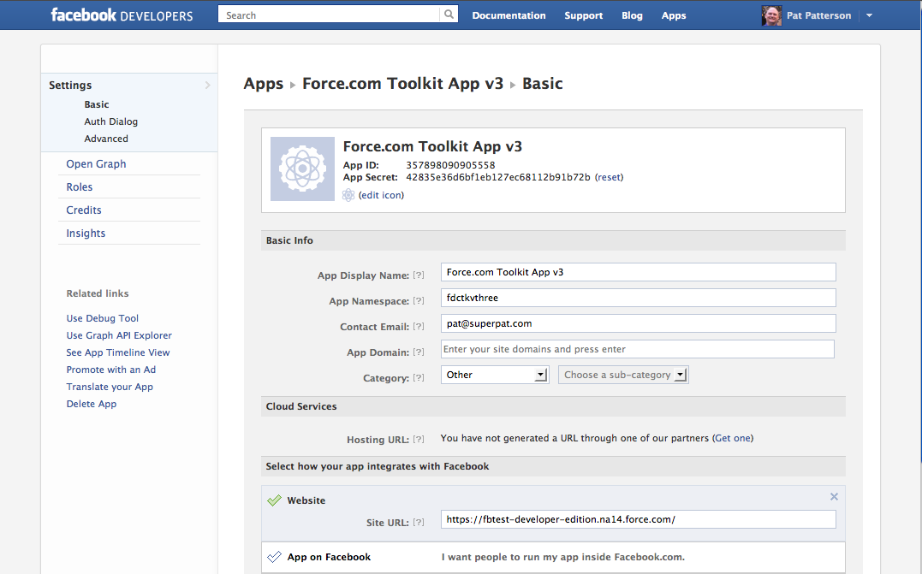
Social Accounts
Each External Login provider has some Developer API
You have to configure an application there before using it
That application will provide you with credentials
Application ID
Application Secret
These credentials will be used by the external provider API
You authenticate yourself with them, when sending a request
These credentials should not be stored in the open world

Slide 36
Social Accounts
On the back-end, it is quite simple, and quite clean
Example: Facebook
If you use the default ASP.NET Core Login page, this will add a form
public void ConfigureServices(IServiceCollection services)
{
...
services.AddAuthentication()
.AddFacebook(facebookOptions => {
facebookOptions.AppId = Configuration["Authentication:Facebook:AppId"];
facebookOptions.AppSecret = Configuration["Authentication:Facebook:AppSecret"];
});
...
}

Slide 37
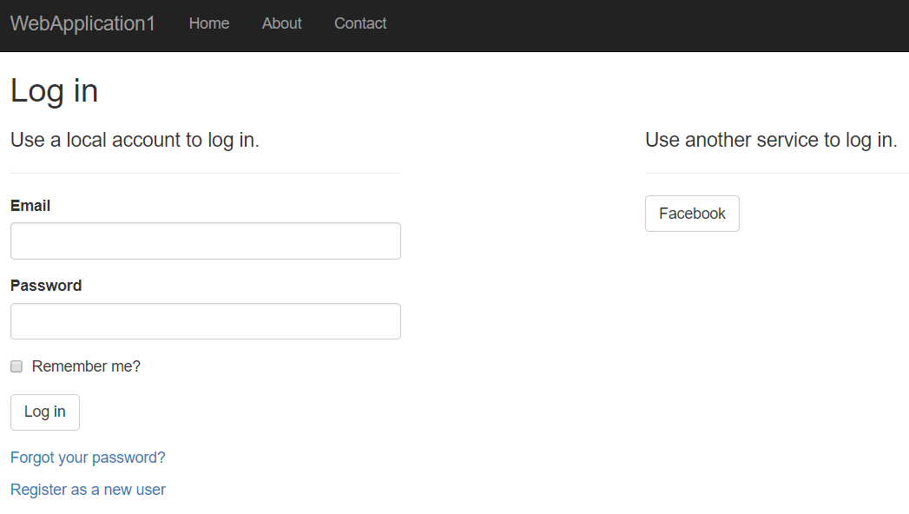
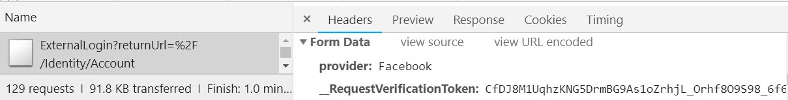
Social Accounts
Sends POST request to /Identity/Account/ExternalLogin
Button submits a parameter: name: provider value: {externalLogin}

Slide 38

GDPR
General Data Protection Regulation (GDPR) is a regulation in EU law
Addresses data protection and privacy of individuals within the EU
It also addresses export of personal data outside of the EU
GDPR aims to:
Provide individuals with more control over their personal data
Simplify the regulatory environment for international businesses
ASP.NET Core provides APIs to help meet some GDPR requirements
There is also a sample app in GitHub here

Slide 39
GDPR
There are several individual rights you must provide your clients
Right to be informed – inform your clients how you use their personal data
Right of access – if a client requests their data, you must provide it
Right to rectification – allow clients to correct inaccurate personal data
Right to erasure – provide clients with the ability to erase their data
Right to restrict processing – allow clients to block processing of their data
Right to portability – allow clients to obtain and reuse their data
Right to object – allow clients to object to the use of their personal data
Rights related to automatic decision making, including profiling

Slide 40



Other Topics
Hosting, Performance, SEO

Slide 41
WebHost
ASP.NET Core apps configure and launch a host
The host is responsible for app startup and lifetime management
At minimum, the host configures a server and request pipeline
In ASP.NET Core the host is configured in the app entry point
public class Program
{
public static void Main(string[] args) { CreateWebHostBuilder(args).Build().Run(); }
public static IWebHostBuilder CreateWebHostBuilder(string[] args) =>
WebHost.CreateDefaultBuilder(args)
.UseStartup<Startup>();
}

Slide 42
WebHost
The CreateDefaultBuilder() method performs several essential tasks
Configuring Kestrel Server, Setting content root, etc.
Loading host configuration, app configuration, etc.
This sets up default config which you can modify using various methods
WebHost.CreateDefaultBuilder(args)
.ConfigureLogging(logging =>
{
logging
.SetMinimumLevel(LogLevel.Warning);
})
...
WebHost.CreateDefaultBuilder(args)
.UseKestrel(options =>
{
options
.Limits.MaxRequestBodySize = 20000000;
})
...

Slide 43


Performance
Performance is an important topic in Web app development
Slow-loading discomforts your clients and drives them elsewhere
There is no magic functionality which optimizes your app
There are many tips, though, on how to speed up your app

Slide 44


Performance
Some of the most important tips include:
Measure everything (Application Insights, dotTrace)
Gather diagnostics for your application
Localize which are the slow components of your application
Analyze what slows down these components
Order and prioritize the most malicious slow-pokes
Pick the low-hanging fruit first
Once you’ve determined the slowest component, prioritize it first

Slide 45

Performance
Some of the most important tips include:
Enable Compression
HTTP Protocol is not particularly efficient
You can enable Response Compression to increase app efficiency
ConfigureServices: services.AddResponseCompression();
Configure: app.UseResponseCompression();
Reduce HTTP Requests
HTTP Communication is quite slow
Reduce amount of HTTP Requests needed for each functionality
Use sprites for images and fonts instead of images

Slide 46
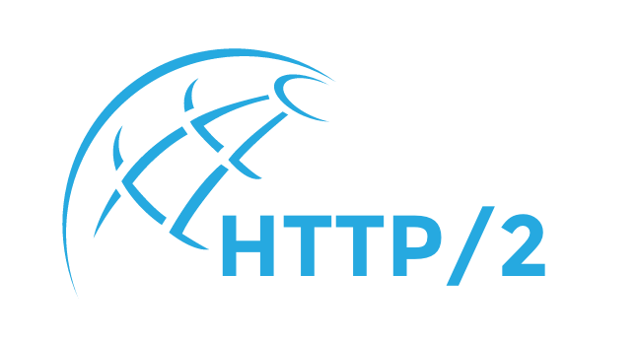
Performance
Some of the most important tips include:
HTTP/2 over SSL (enabled by default in 2.2)
HTTP/2 Protocol introduces many significant features
These features can optimize your apps greatly
Minify your fields (bundleconfig.json)
Compression is a great tool
Your third-party resources are unnecessarily slowing your app
You can minify them in order to reduce the data traffic

Slide 47
Performance
Some of the most important tips include:
Load CSS First
CSS Content must be loaded first, preferably in the head section
Browsers tend to do unnecessary actions when rendering pages
Load JS Last
Pages need to be rendered as quickly as possible
JavaScript is not particularly needed for the rendering of pages
Of course, this is only applicable to non-heavy JavaScript sites

Slide 48
Performance
Some of the most important tips include:
Cache your pages
There is a lot of static, unchangeable content on web app pages
The process of its slow retrieval does not need to be repeated
Content Delivery Network (CDN)
CDN outsources a bit of work from your application
There are plenty of CDNs closely-located to your clients
CDNs are a preferred resource in Production Environment

Slide 49

Search Engine Optimization (SEO)
Search Engine Optimization is very important in web apps
Common users tend to use Google / Bing to look for services
There are ways to boost your place in the results of SEs
There are several simple tips you can follow:
Prioritize Visible Content, Eliminate JavaScript block-rendering
Make your application crawlable and fast
Make your URLs meaningful
Unique and relevant title and description with keywords

Slide 50

AutoMapper
Simplify object mapping

Slide 51



Auto Mapper
AutoMapper is a library built to simplify object mapping
Easily imported in ASP.NET Core
Added as a dependency to the DI
Easy to use in code
Gets rid of ugly property setters
Used in millions of projects
Highly flexible
Easily configurable

Slide 52

Auto Mapper
Setting up the AutoMapper in your ASP.NET Core project
This will also install the main AutoMapper NuGet package
Registering AutoMapper as a dependency in the DI
Install-Package AutoMapper.Extensions.Microsoft.DependencyInjection
public void ConfigureServices (IServiceCollection services)
{
...
services.AddAutoMapper();
services.AddMvc();
}
public class HomeController : Controller
{
private readonly IMapper mapper;
public HomeController(IMapper mapper)
{
this.mapper = mapper;
}
...
}

Slide 53
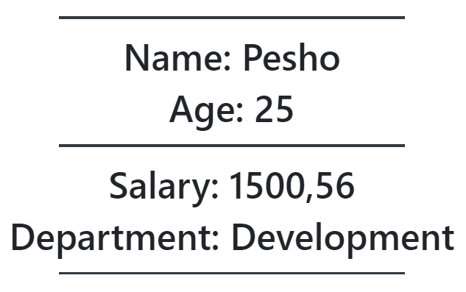
Auto Mapper (Data & Presentation)
Using the AutoMapper in your ASP.NET Core project
public class HomeDataModel
{
public string Id { get; set; }
public string Name { get; set; }
public int Age { get; set; }
public decimal Salary { get; set; }
public string Resume { get; set; }
public string Department { get; set; }
}
public class HomeViewModel
{
public string Name { get; set; }
public int Age { get; set; }
public decimal Salary { get; set; }
public string Department { get; set; }
}
@model Demo.App.Models.HomeViewModel
<div class="mt-4">
<h1 class="text-center">Name: @Model.Name</h1>
<h1 class="text-center">Age: @Model.Age</h1>
<h1 class="text-center">Salary: @Model.Salary</h1>
<h1 class="text-center">Department: @Model.Department</h1>
</div>

Slide 54
Auto Mapper (Business Logic)
Without AutoMapper
Ugly, mistake-prone, unreadable
With AutoMapper
Clean, beautiful, simple
Commonly-syntaxed
Easily modifiable
public IActionResult Index()
{
var homeDataModel = this.GetHomeDataModel();
var homeViewModel = new HomeViewModel
{
Name = homeDataModel.Name,
Age = homeDataModel.Age,
Department = homeDataModel.Department,
Salary = homeDataModel.Salary
};
return this.View(homeViewModel);
}
public IActionResult Index()
{
var homeDataModel = this.GetHomeDataModel();
var homeViewModel = this.mapper
.Map<HomeViewModel>(homeDataModel);
return this.View(homeViewModel);
}

Slide 55
Integrating AutoMapper
Live Demo

Slide 56
Repository Pattern and AutoMapper
Abstracting the data access logic

Slide 57
Repository Pattern
Repositories are components that encapsulate data access logic
They centralize common data access functionality
They provide better maintainability and testability
They decouple the data access infrastructure from the Domain layer
For each aggregate, you should define one Repository
Repositories, basically, allow you to populate data in-memory
Data is mapped from database to Domain Entities
Once in-memory, entities can be changed and persisted back

Slide 58


Repository Pattern
Normally you implement specific Interface-Class pairs.
There are other ways, though. Like Generic Repositories, for example
public interface IRepository<TEntity>
{
IQueryable<TEntity> All();
void Add(TEntity entity);
void Update(TEntity entity);
void Delete(TEntity entity);
Task<int> SaveChangesAsync();
}
public class EfRepository<TEntity> : IRepository<TEntity>
{
private ApplicationContext context;
private DbSet<TEntity> dbSet;
public StudentRepository(ApplicationContext context)
{
this.context = context;
this.dbSet = this.Context.Set<TEntity>();
}
public IQueryable<TEntity> All() => this.DbSet;
public void Add(TEntity entity) => this.DbSet.Add(entity);
public void Update(TEntity entity) { ... }
public void Delete(TEntity entity) { ... }
public Task<int> SaveChangesAsync() { ... }
}

Slide 59

Summary
Sessions, Cache, TempData
Authentication & Authorization Fundamentals
GDPR
Hosting & Environment
Performance & SEO
Repository & AutoMapper
…
…
…

Slide 60
https://softuni.bg/trainings/courses

Slide 61













SoftUni Diamond Partners

Slide 62





SoftUni Organizational Partners

Slide 63




Trainings @ Software University (SoftUni)
Software University – High-Quality Education and Employment Opportunities
softuni.bg
Software University Foundation
http://softuni.foundation/
Software University @ Facebook
facebook.com/SoftwareUniversity
Software University Forums
forum.softuni.bg

Slide 64

License
This course (slides, examples, demos, videos, homework, etc.) is licensed under the "Creative Commons Attribution-NonCommercial-ShareAlike 4.0 International" license

